Slide 1
Automating the Creation of User Accounts
After this lesson, you will be able to:
Create users from user account templates.
Import users with CSVDE.
Set password with PowerShell
Enable account with PowerShell
Verify users account using PowerShell
Move users from one OU to another

Slide 2
Creating Users with Templates
Users in a domain often share many similar properties. For example, all sales representatives can belong to the same security groups, log on to the network during similar hours, and have home folders and roaming profiles stored on the same server. When you create a new user, you can simply copy an existing user account rather than create a blank account and populate each property.
To create a user based on the template, perform the following steps:
Create an OU called Iceland, then create OU Sales under Iceland OU
In the Sales OU create a group called Sales_Group
Create a user template name it _Sales User
Right-click the template user account, and then click Copy. The Copy Object – User Wizard appears.
In the First Name box, type the user’s first name.
In the Last Name box, type the user’s last name.
Modify the Full Name value if necessary.

Slide 3
Creating Users with Templates
8. In the User Logon Name box, type the user logon name, and then select the
appropriate user principal name (UPN) suffix in the drop-down list.
9. In the User Logon Name (Pre-Windows 2000) box, type the user’s pre–Windows
2000 user name, and then click Next.
10. In Password and Confirm Password, type the user’s password.
11. Select the appropriate password options.
12. If the user account from which the new user account was copied was disabled,
clear the Account Is Disabled check box to enable the new account.
13. Click Next, and then click Finish.

Slide 4
Creating Users with Templates
General tab No properties are copied from the General tab.
Address tab P.O. box, city, state or province, ZIP or postal code, and country
or region are copied. Note that the street address itself is not copied.
Account tab Logon hours, logon workstations, account options, and account expiration are copied.
Profile tab Profile path, logon script, home drive, and home folder path are copied.
Organization tab Department, company, and manager are copied.
Member Of tab Group membership and primary group are copied.

Slide 5
Creat a user with Powershell
Lets create a new user called Will Lanz
New-ADUser creates new user
New-ADUser -Name "Will Lanz“ -SamAccountName "wlanz"
-GivenName "Will" -Surname "Lanz“ -DisplayName "Will Lanz“
-UserPrincipalName "will@abdel.local"
-Path "OU=Sales,OU=Iceland,DC=abdel,DC=local“ –Department “Sales”

Slide 6
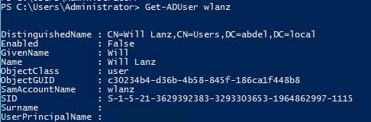
Get-ADUser
Figure 7
Get-ADUser dislays the information about a user account
Get-ADUser wlanz
Note that the Enable option is set to false means that the user account is disabled.

Slide 7
Set a Password
Set-ADAccountPassword-identity sets a password
To enable the user account we need to set login passwod.
Lets create a password
Set-ADAccountPassword-identity wlanz-Reset-NewPassword(ConvertTo-SecureString-AsPlainText”2015P@ssword” -Force)

Slide 8
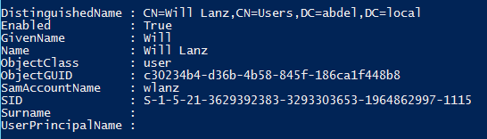
Enable user account
Enable-ADAccount –identity command enables the user account.
Enable-ADAccount -Identity wlanz

Slide 9
Create user
Create user accont, set login password and enable the account.
New-ADUser -Name "Vito Corleone" -SamAccountName "Vcorleone"
-GivenName "Vito" -Surname "Corleone" -DisplayName "VitoCorleone"
-UserPrincipalName "vito@abdel.local" -Enabled $true
-Path "OU=Sales,OU=Iceland,DC=abdel,DC=local" -Department "Sales"
-AccountPassword (ConvertTo-SecureString "Pa$$w0rd"
-AsPlainText -Force)
The preceding code we used the New-ADUser cmdlet again, but this time two parameters –AccountPassword and –Enabled were added to securely configure a password and to enable the account.

Slide 10
Creat user continued
Create user accont, set login password and enable the account.
New-ADUser -Name "Vito Corleone" -SamAccountName "Vcorleone"
-GivenName "Vito" -Surname "Corleone" -DisplayName "VitoCorleone"
-UserPrincipalName "vito@abdel.local" -Enabled $true
-Path "OU=Sales,OU=Iceland,DC=abdel,DC=local" -Department "Sales"
-AccountPassword (ConvertTo-SecureString "Pa$$w0rd"
-AsPlainText -Force)
The preceding code we used the New-ADUser cmdlet again, but this time two parameters –AccountPassword and –Enabled were added to securely configure a password and to enable the account.

Slide 11
Managing Multiple AD User Accounts
Hundreds and even thousands of user accountants can be created and managed in Active Directory with a few lines of code. Let’s demonstrate this procedure by importing the user names and properties from a comma-separated value (CSV) file.
Let’s say that you need to create several user accounts, you can generate a CSV file with all the accounts’ information and use the Import-CSV cmdlet to import and then pipe that data to the New-ADUser cmdlet.
The New-ADUser cmdlet picks up all the parameters names and values from the PowerShell pipeline and creates the user accounts in the directory.
The figure below shows the CSV file used in our demonstration.

Slide 12
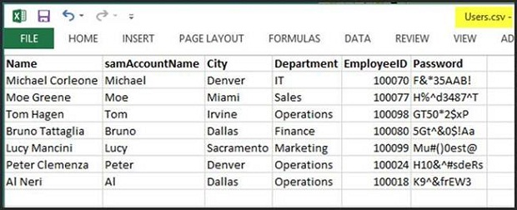
Managing Multiple AD User Accounts
CSV File

Slide 13
Managing Multiple AD User Accounts
Once the CSV file is ready, running the following script will create all the user accounts in the directory.
Import-Csv -Path c:\scripts\users.csv | foreach {New-ADUser -Name $_.Name -SamAccountName $_.samAccountName -City $_.city -Department $_.Department -EmployeeID $_.EmployeeID -AccountPassword(ConvertTo-SecureString $_.password -AsPlainText -Force) -Enabled $true -Path "OU=Sales,OU=Iceland,DC=abdel,DC=local"}

Slide 14
Managing Multiple AD User Accounts
Let’s verify that the user accounts were created in the Sales OU by executing this code:
Get-ADUser -Filter * -SearchBase "OU=Sales,OU=Iceland,dc=abdel,dc=local" | Format-table Name,Distinguishedname,Enabled –AutoSize

Slide 15
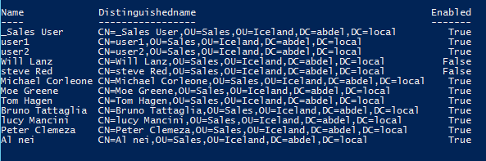
Managing Multiple AD User Accounts

Slide 16
Moving Objects with powershell
Once the user accounts are created, many managing and maintenance tasks can be automated using Windows PowerShell. For example, the figure above shows that there are nine accounts in the Sales OU. Let’s say that we want to move all these users to the Finance OU. This code will complete the task:
Get-ADUser -Filter * -SearchBase "OU=Sales,OU=Iceland,dc=abdel,dc=local" |
Move-ADObject -TargetPath "OU=Finance,DC=abdel,DC=local"

Slide 17
Removing Objects with powerShell
To filter all the users in the in OU called “Reykjavik”
We can use:
Get-ADUser -filter * -SearchBase "ou=Reykjavik,dc=abdel,dc=local"
We can also filter the users and remove them:
Get-ADUser -filter * -SearchBase "ou=Reykjavik,dc=abdel,dc=local" | Remove-ADUser

Slide 18
Removing OUs
To remove an OU that is protected by accidental deletion you need to remove the accidental deletion first:
Set-ADOrganizationalUnit -ProtectedFromAccidentalDeletion:$false -PassThru -Identity "ou=Reykjavik,dc=abdel,dc=local"
To remove an OU use:
Remove-ADOrganizationalUnit -Identity "ou=Reykjavik,dc=abdel,dc=local" -server "dc1" -Confirm:$false

Slide 19
Removing OUs
You can’t remove an OU that have child OUs:
Remove child OUs first then the parent OU:
Remove-ADOrganizationalUnit -Identity "ou=Reykjavik,dc=abdel,dc=local" -server "dc1" -Confirm:$false
Error : Remove-ADOrganizationalUnit : The operation cannot be performed because child objects exist

